Slide 1



Slide 2
Abstract
This project involves building an attendance system which utilizes facial recognition to mark the presence, time-in, and time-out of employees. It covers areas such as facial detection, alignment, and recognition, along with the development of a web application to cater to various use cases of the system such as registration of new employees, addition of photos to the training dataset, viewing attendance reports, etc. This project intends to serve as an efficient substitute for traditional manual attendance systems. It can be used in corporate offices, schools, and organizations where security is essential.

Slide 3
Introduction
This project aims to automate the traditional attendance system where the attendance is marked manually. It also enables an organization to maintain its records like in-time, out time, break time and attendance digitally. Digitalization of the system would also help in better visualization of the data using graphs to display the no. of employees present today, total work hours of each employee and their break time. Its added features serve as an efficient upgrade and replacement over the traditional attendance system.

Slide 4
Software Requirements Specification - SRS
We have 2 types of users of the system:
1.Employee
2.Admin
Following functionalities can be performed by the admin:
•Login
•Register new employees to the system
•Add employee photos to the training data set
•Train the model
•View attendance report of all employees. Attendance can be filtered by date or employee.
Following functionalities can be performed by the employee:
•Login
•Mark his/her time-in and time-out by scanning their face
•View attendance report of self.

Slide 5
Functional Requirements
1.1 Manage Registration and Login
1.1.1 Register new employee
Description: Admin can register new
Input: Employee Details
Output: success message displaying the user has been created.
1.1.2 Log-In to the system
Input: User credentials
Output: If the credentials are correct, user will be redirected to the dashboard of the
system
Exception Flow: If the entered credentials are incorrect then user will be redirected
to the login page again displaying an error message.

Slide 6
1.2 Manage Attendance Details
1.2.1 Mark your attendance-in
Input: User will scan his/her face using the external web camera.
Output: system will identify the user uniquely and will mark his/her in-time to the database. The same success message will be transmitted to the user.
1.2.2 Mark your attendance-out
Input: User will scan his/her face using the external web camera.
Output: system will identify the user uniquely and will mark his/her out-time to the database. The same success message will be transmitted to the user.

Slide 7
1.2.3 View my attendance report
Description: Employee may often need to see his / her attendance record throughout the month or year. Using this feature one can see his / her attendance record till the date.
Input: User selection
Output: Statistical analytics of the particular employee who is currently logged into the system will be displayed.
1.2.4 View employee’s attendance report
Description: This feature is for admin. Admin can monitor the availability of each employee till the date. i.e., how many employees are present today out of total employees etc. can be monitored.
Input: user selection
Output: Attendance record of each employee including how many employees are present today out of total along with the availability graph.

Slide 8
1.3 Manage Employee Details
1.3.1 Add photo of the employee
Description: Admin only can access this feature. Admin can add a photo of an employee during the registration process.
Input: Username of an employee
Output: Success message record has been added.
Process: System will process an image and will generate necessary system data to identify each employee uniquely.
1.3.2 Train the system
Input: user selection
Output: system will process all the available records of the employees and will generate necessary system data to identify each employee uniquely.

Slide 9
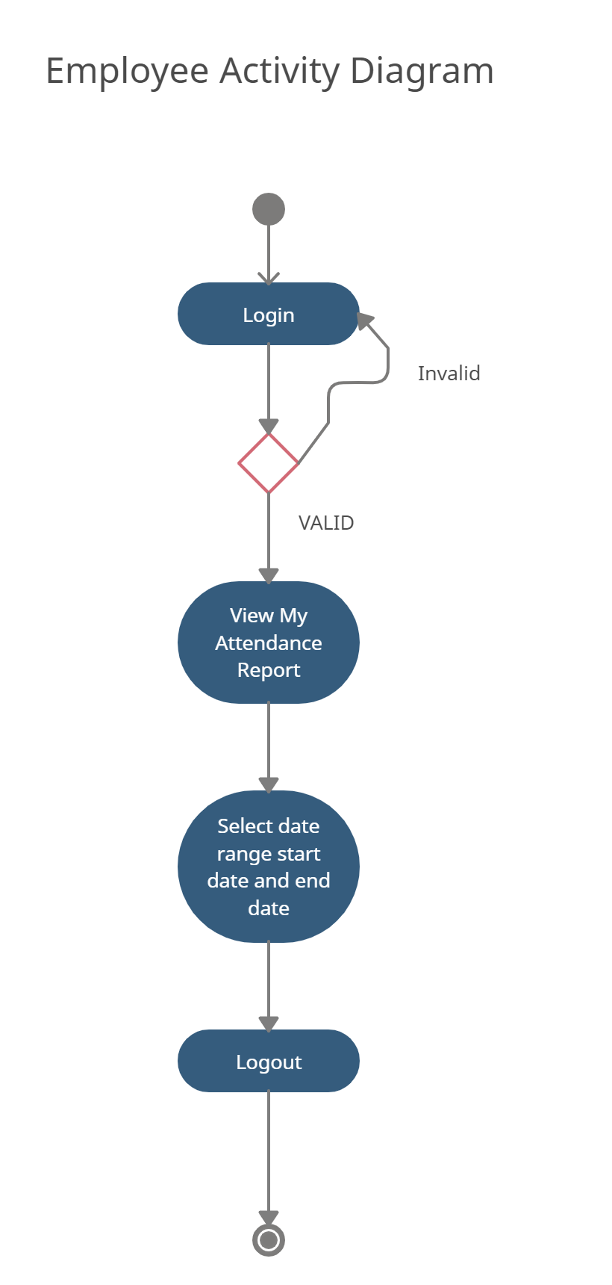

Slide 10
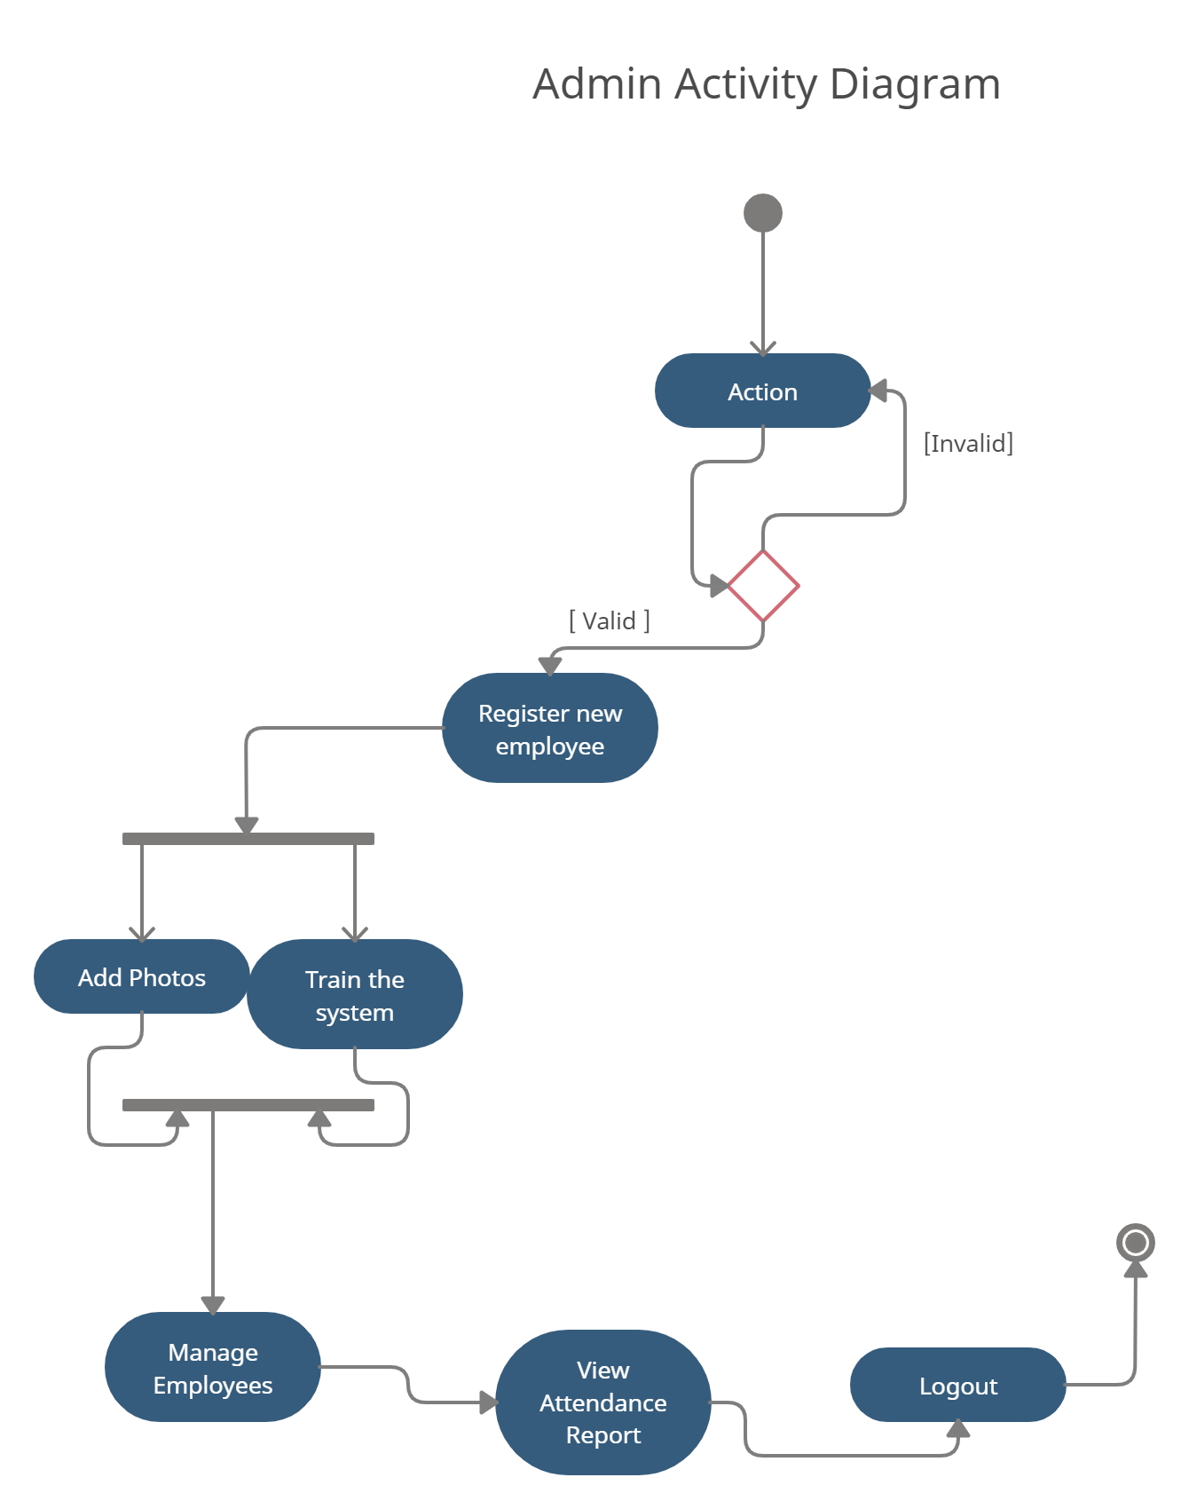

Slide 11
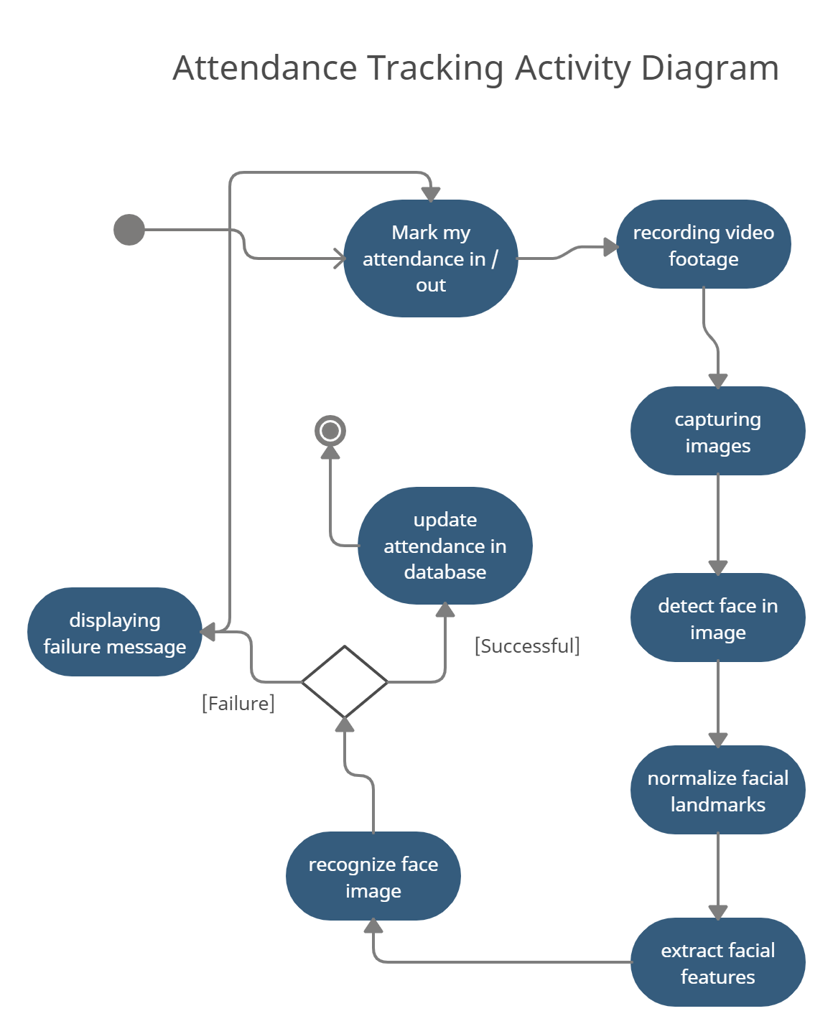

Slide 12
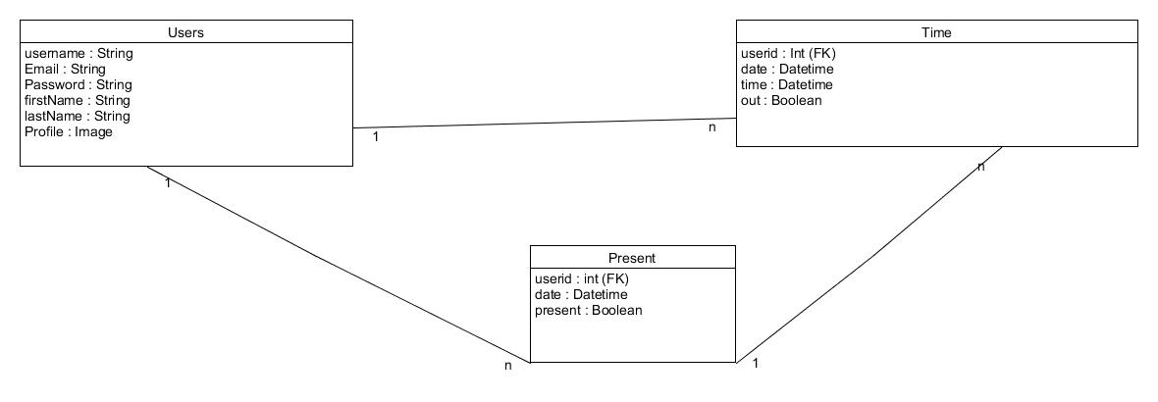

Slide 13
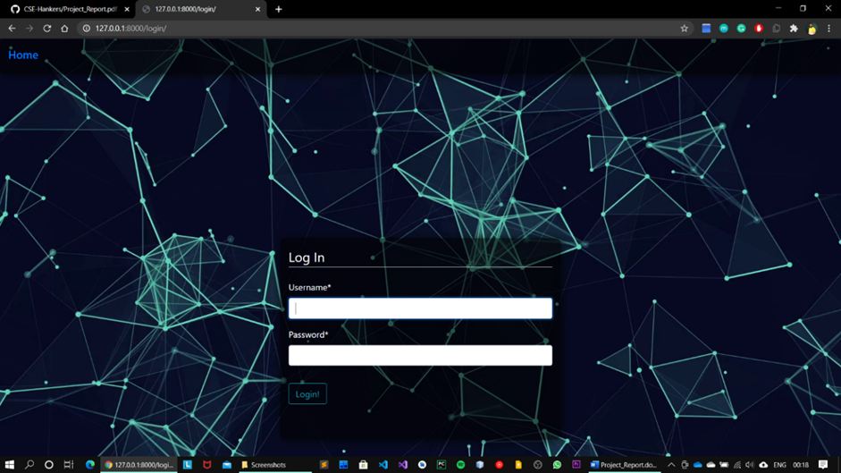
Screenshots Login

Slide 14
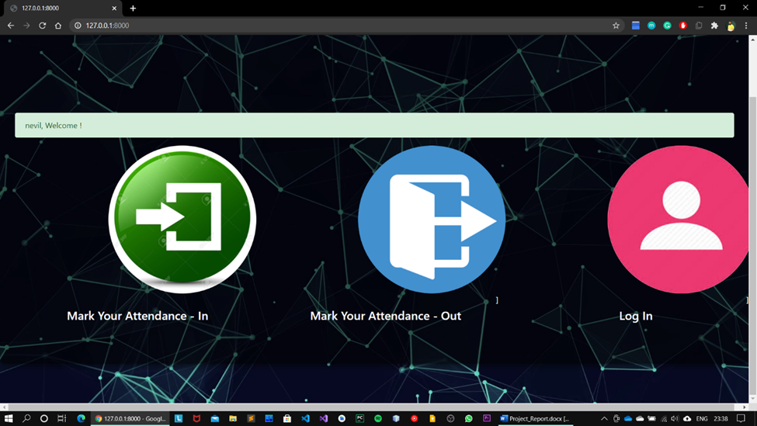
Mark my attendance In / Out

Slide 15
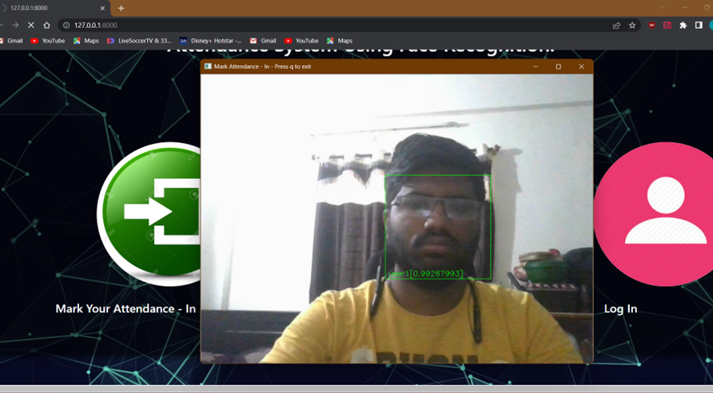
Scanning Face

Slide 16
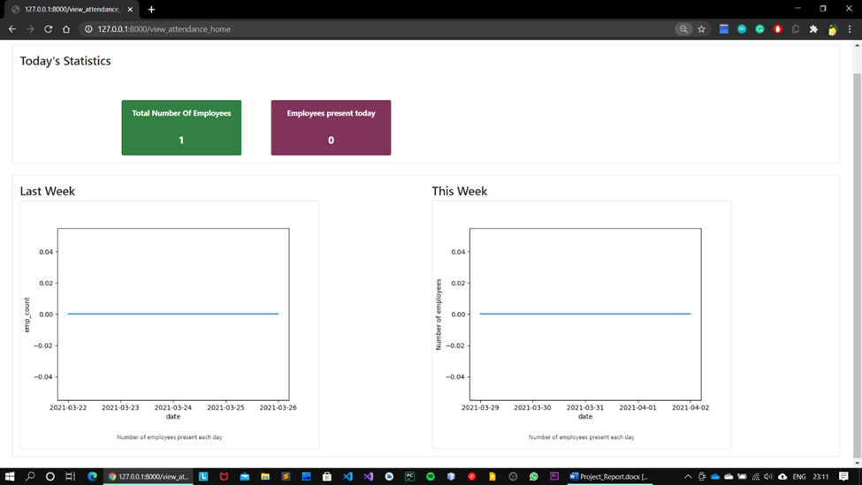
View Attendance Records by Admin

Slide 17
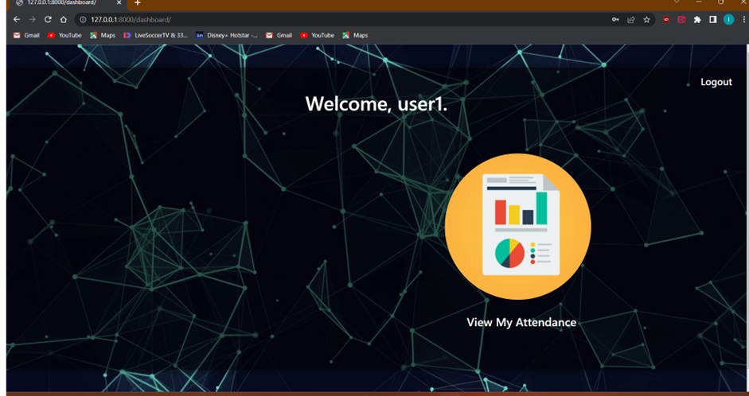
Employee Dashboard

Slide 18
Scope of Project
Facial recognition is becoming more prominent in our society. It has made major progress in the field of security. It is a very effective tool that can help low enforcers to recognize criminals and software companies are leveraging the technology to help users access the technology. This technology can be further developed to be used in other avenues such as ATMs, accessing confidential files, or other sensitive materials.
This project servers as a foundation for future projects based on facial detection and recognition. This project also convers web development and database management with a user-friendly UI. Using this system any corporate offices, school and organization can replace their traditional way of maintaining attendance of the employees and can also generate their availability(presence) report throughout the month.

Slide 19
Future Scope
A feature which can give intruder alert can be included in the system. Furthermore, the images of unknown people can be saved in an efficient manner and displayed in the system for better security.
The number of training images can be reduced so that less storage is required. This can be done by removing duplicate images of the same person, or images with similar embeddings.
The training time can be reduced by retraining the classifier only for the newly added images.
A feature can be added where an employee is automatically sent a warning if his attendance or working hours are below the threshold.
Wrongly classified images can be added to the training dataset with the correct label so as to increase the accuracy of the recognition model.

Slide 20
Technology/Platform/Tools used
Technology:
Django
OpenCV
Dlib
Open-Source
Face Recognition Library
SQLITE Database.
JavaScript
Bootstrap
Platform:
Windows
Linux
Tools:
Visual Studio Code

Slide 21
Conclusion
Functionalities implemented successfully
Registration
Login / Logout
Manage User Profile
Update user profile
View My Attendance
View Attendance by Date
View Attendance by Employee
Manage Attendance
Mark my attendance In
Mark my attendance Out
Add photos
Add new employee
Train the system
View Attendance record by date
View no. of employee present today
View Total number of employees

Slide 22
THANK YOU

